Slide 1
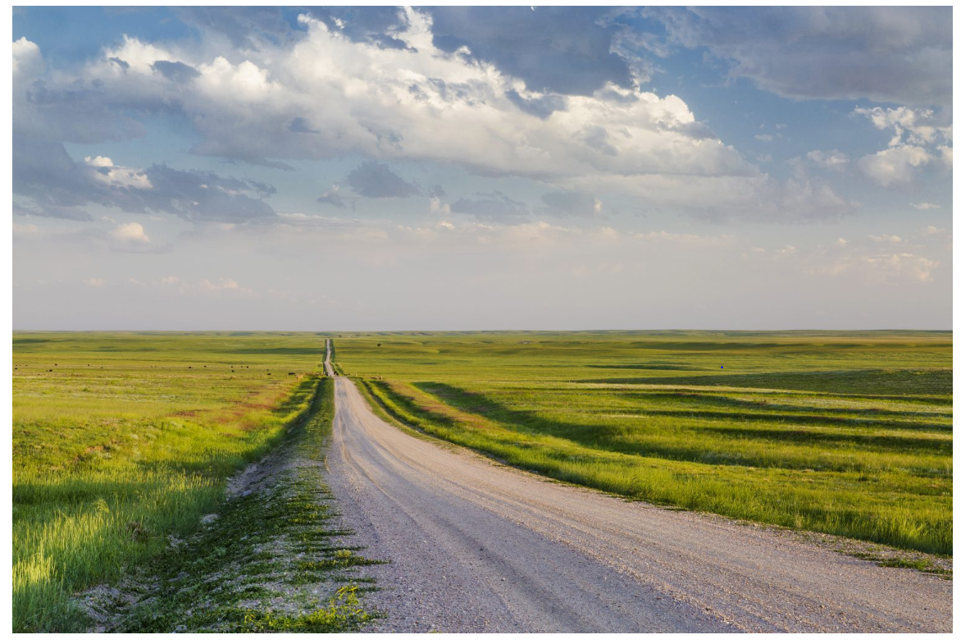
Teaching in Small Rural Schools
Valerie JH Sherman
Rural Education Coordinator, Colorado Center for Rural Education, University of Northern Colorado
Dr. Harvey Rude
Executive Director, Colorado Center for Rural Education, University of Northern Colorado

Slide 2
Introductions

Slide 7
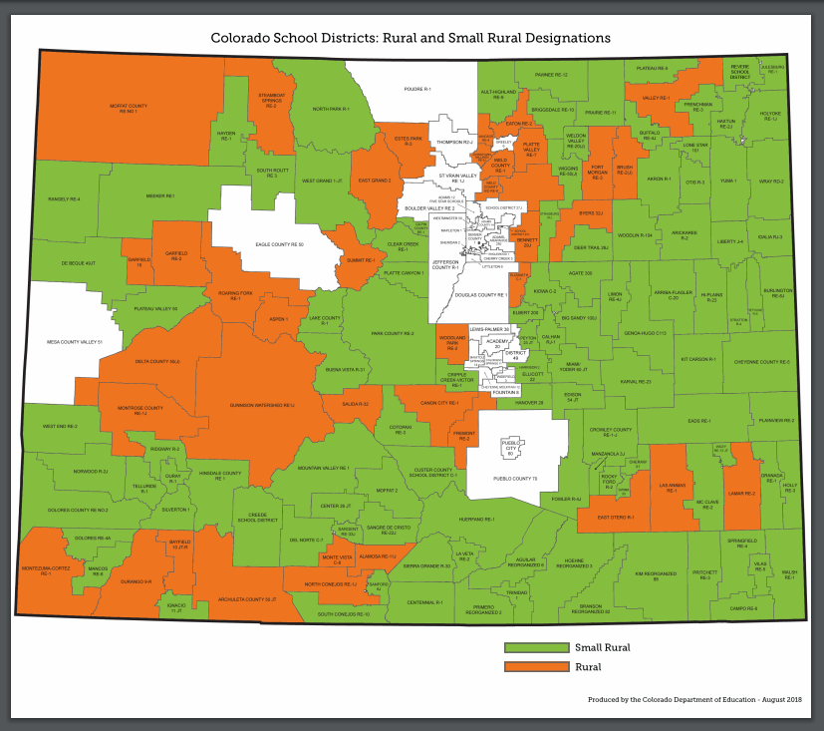

Slide 8
Colorado Educator Preparation Institution of Higher Education Completers 2010-2016
Since 2010, Colorado has had a 24.4% decline in the number of educators completing an educator preparation program at our colleges and universities.

Slide 9
2015-2016: Significant declines in math, science and English language arts.

Slide 10
Recruitment-related Stipends

Slide 11
Colorado Rural Teaching Stipend
(2017-2018)
Award: $2800 during student teaching semester
Placed in a rural school district
Apply to and work in a rural school district after graduation for two years
Receive half of the stipend at the start of student teaching
Remaining half after completing student teaching and having applied to work in rural school district.

Slide 13
Retention-related Efforts

Slide 14
Concurrent Enrollment Educator Qualification Stipend
Award: $6,000
Graduate-level coursework (six or so)
Colordo Approved program
Three year rural commitment
Receive half the stipend at the start of the program
Remaining half after successful plan of study completion and fully qualified to teach concurrent enrollment courses.

Slide 16
National Board Certified Teacher (2018-on)
Award: $3,975 Enroll with the National Boards
Register for each of the four components of the National Board portfolio
2-year Colorado Rural National Board cohort
Receive half at the start of the program and the remaining half once Board Certified
Three year rural commitment

Slide 18
Rural Alternative Licensure Stipend (2018-on)
Award: Up to $6,000
Alternative Licensure program;
PRAXIS;
Alternative License;
Initial License;
Assorted (e.g., technology- and travel-related costs)
Half the stipend amount at the start, half after obtaining Initial license
Three year rural commitment

Slide 20
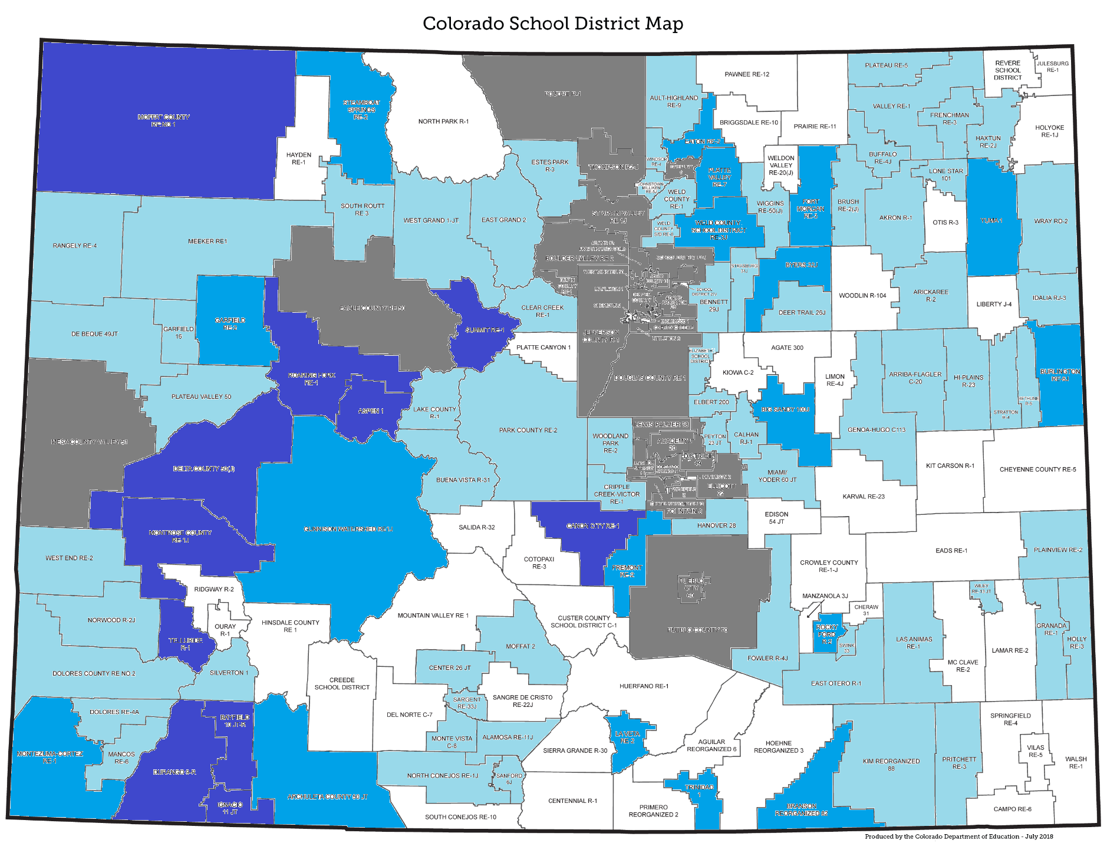
CCRE Stipend Awards (all): 2017-2018
Key
 | 1-3
 | 4-5
 | 6+

Slide 21
Rural Recruitment Events
If you build it, they will come…

Slide 22
Rural Education Expo
Friday, March 29, 2019
CSU-Pueblo
11:30-3:30
Meet And Greets
Classroom Management Info Session
Lunch
School of Education Dean

Slide 23
Great Northwest Rural Education Recruiting Event
April 13-14, 2019
Preservice: Tours of school districts
High-school student: Education Exploration
Transportation to and from Steamboat
Overnight lodging and most meals

Slide 24
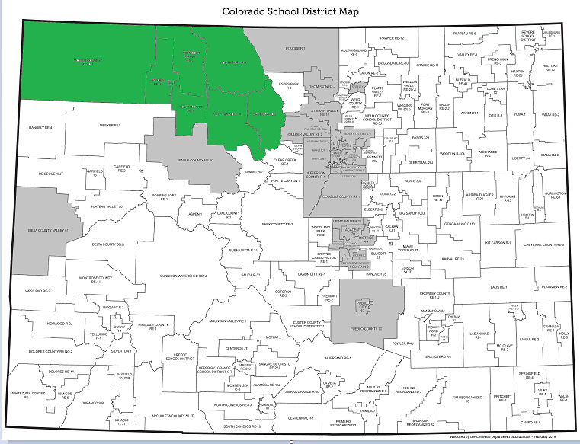

Slide 25
East Central Immersion and Recruiting Event
April 16-18, 2019
Nine East-central school districts
Lodging: local hand-picked families
Partner with hand-picked master teachers

Slide 28
Harvey Rude, Ph.D.
Director
Harvey.rude@unco.edu
Valerie JH Sherman, Ph.D.
Rural Education Coordinator
valerie.sherman@unco.edu
www.unco.edu/colorado-center-for-rural-education

